Slide 1
LDA Implementation
Machine Learning Course
Spring 2015
Tsinghua University

Slide 2
Goal
Classify the given documents into K topics.
In other words, the goal is detecting K topics from the input documents.
You can define K by your own.
Try different K and choose the one with the best performance.

Slide 3
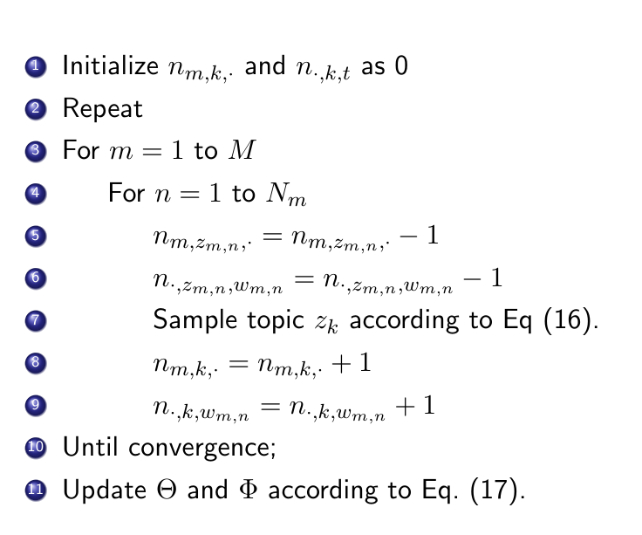
Algorithm
Please refer to the slides of topic models

Slide 4
Input Data Set
Input data is in data.txt
Line 1: the number of document N
Line 2~N+1: the title of one paper (document). Please use it as the input words.

Slide 5
Learning Processing
Input:
data.txt
Steps:
Set the number of topics k = 3
Execute the algorithm and store the necessary parameters.
Calculate log likelihood in page 8.
Change value of k in step (1) , and repeat step (2) and (3).
Find the optimal k with highest log likelihood (loglikelihood is almost not changed).

Slide 6
Topic Explanation
For each topic, you need to output 10-20 words which can represent this topic mostly (according to P(word | topic)).
Format:
Topic N
Word0: P(word0 | topic1)
Word1: P(word1 | topic1)
…
Word9: P(word9 | topic1)
Sample Format
Topic 0:
xml : 0.0583963202110139
web : 0.057087699376350685
applications : 0.030795841329174938
memory : 0.020921769807951327
search : 0.018483653427648843
dynamic : 0.018427154509412905
services : 0.016879383281509983
scalable : 0.016272487640877763
caching : 0.014417515423239591
multidatabase : 0.011623205457770179
Topic 1:
processing : 0.07866660388768165
……

Slide 7
Submission
Submit as .tar file, including
Source Code with necessary comments
ReadMe explaining
Explain main functions, including data input, Gibbs sampling, parameter calculation, output.
How to run your code.
What’s the final average log-likelihood and time cost of different topics. (better plot a chart)
Explain topics as in page 6.

Slide 8
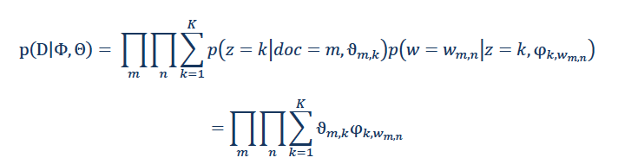
Likelihood
Log-likelihood : the logarithm of likelihood

Slide 9
Reference
D.M.Blei,A.Y.Ng,andM.I.Jordan.Latentdirichletallocation. Journal of Machine Learning Research, 3:993–1022, 2003.

Slide 10
Thank You!

